Slide 1
DATA VISUALIZATION PRINCIPLES
Juan Intan Kanggrawan
Head of Data & Analytics

Slide 2

INTRO

Slide 3
AGENDA
1
JAKARTA SMART CITY: OVERVIEW & EVOLUTION
2
STRATEGIC ROLES OF ANALYTICS TEAM
3
DATA VISUALIZATION PRINCIPLES

Slide 4
1
JAKARTA SMART CITY: OVERVIEW & EVOLUTION

Slide 5
SMART CITY 4.0
CITY
The city government as a collaborator. Citizens as co-creators.
4.0
CITY
The city government as a facilitator. Citizens as participants.
3.0
4 LEVELS OF
CITY EVOLUTION
CITY
The city government as a service provider. Citizens as consumers.
2.0
CITY
The city government as an administrator. Citizens as residents.
1.0

Slide 6

JSC Lounge

Slide 7

JSC Team

Slide 8
2
STRATEGIC ROLES OF ANALYTICS TEAM

Slide 9
Role of Data & Analytics:
“to make better decisions, faster”
Alignment with JSC’s Vision:
“To improve satisfaction from citizen towards government, through data-driven public policy & public services”

Slide 10
DATA VARIETIES
Urban/City Data
Citizen Aspiration
Transport
Tax
Subsidy
Health
Education
Flood
Waste
(Not Exhaustive List)

Slide 11
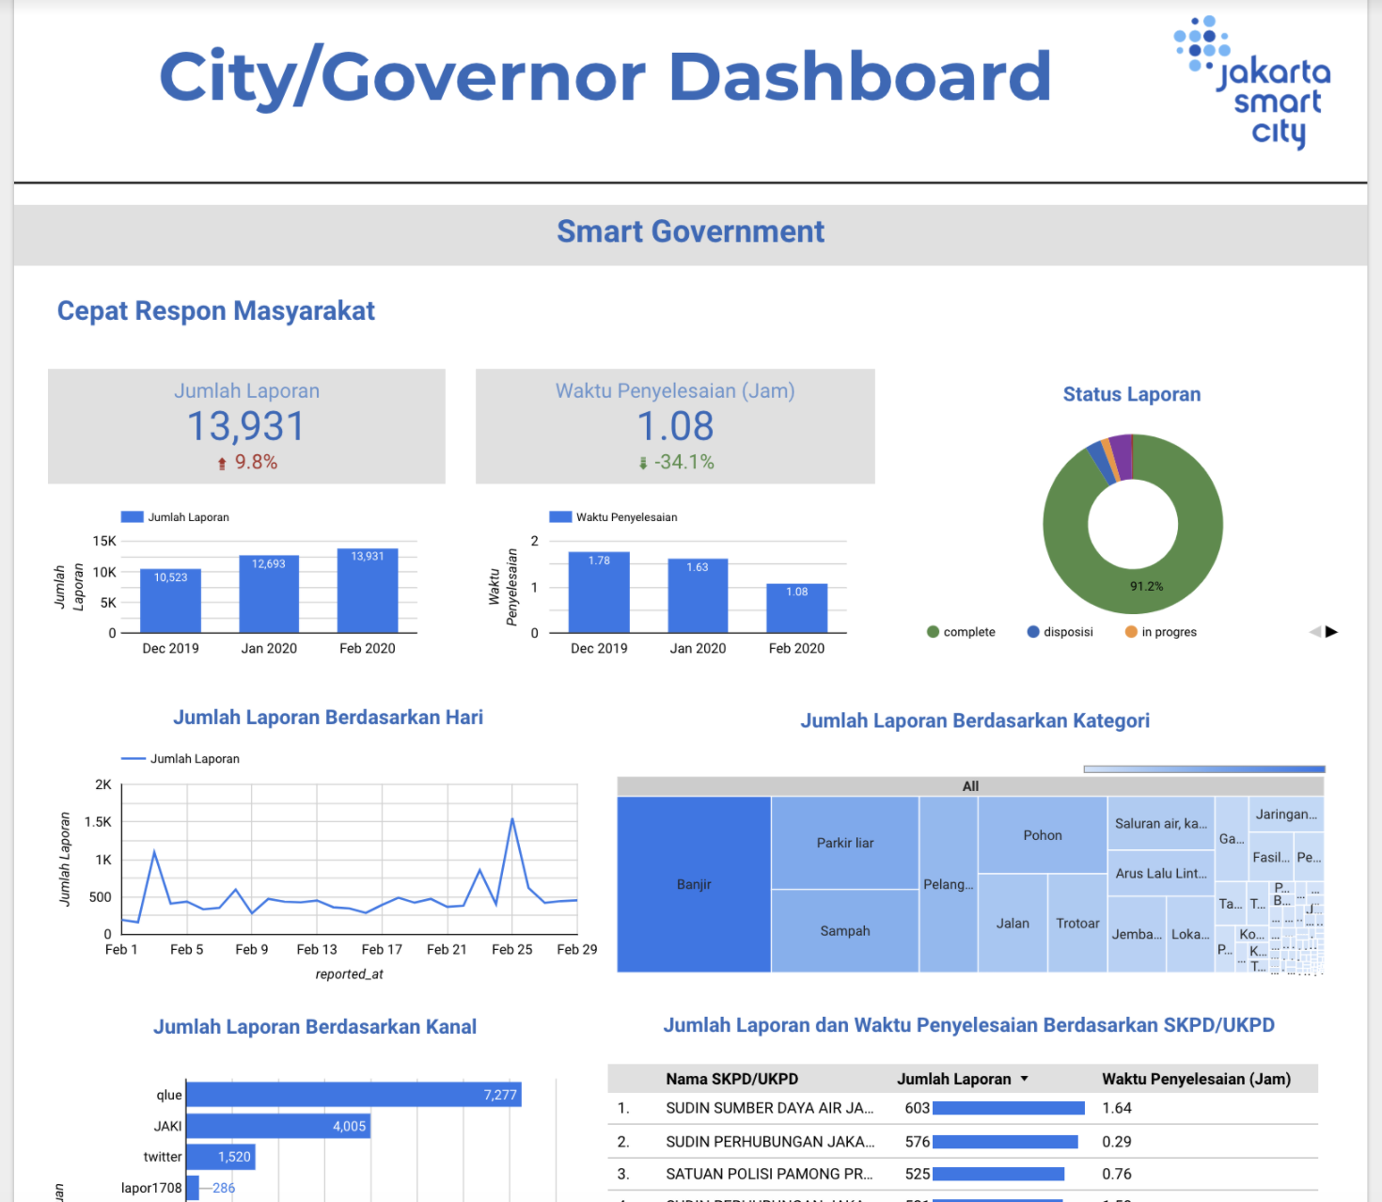
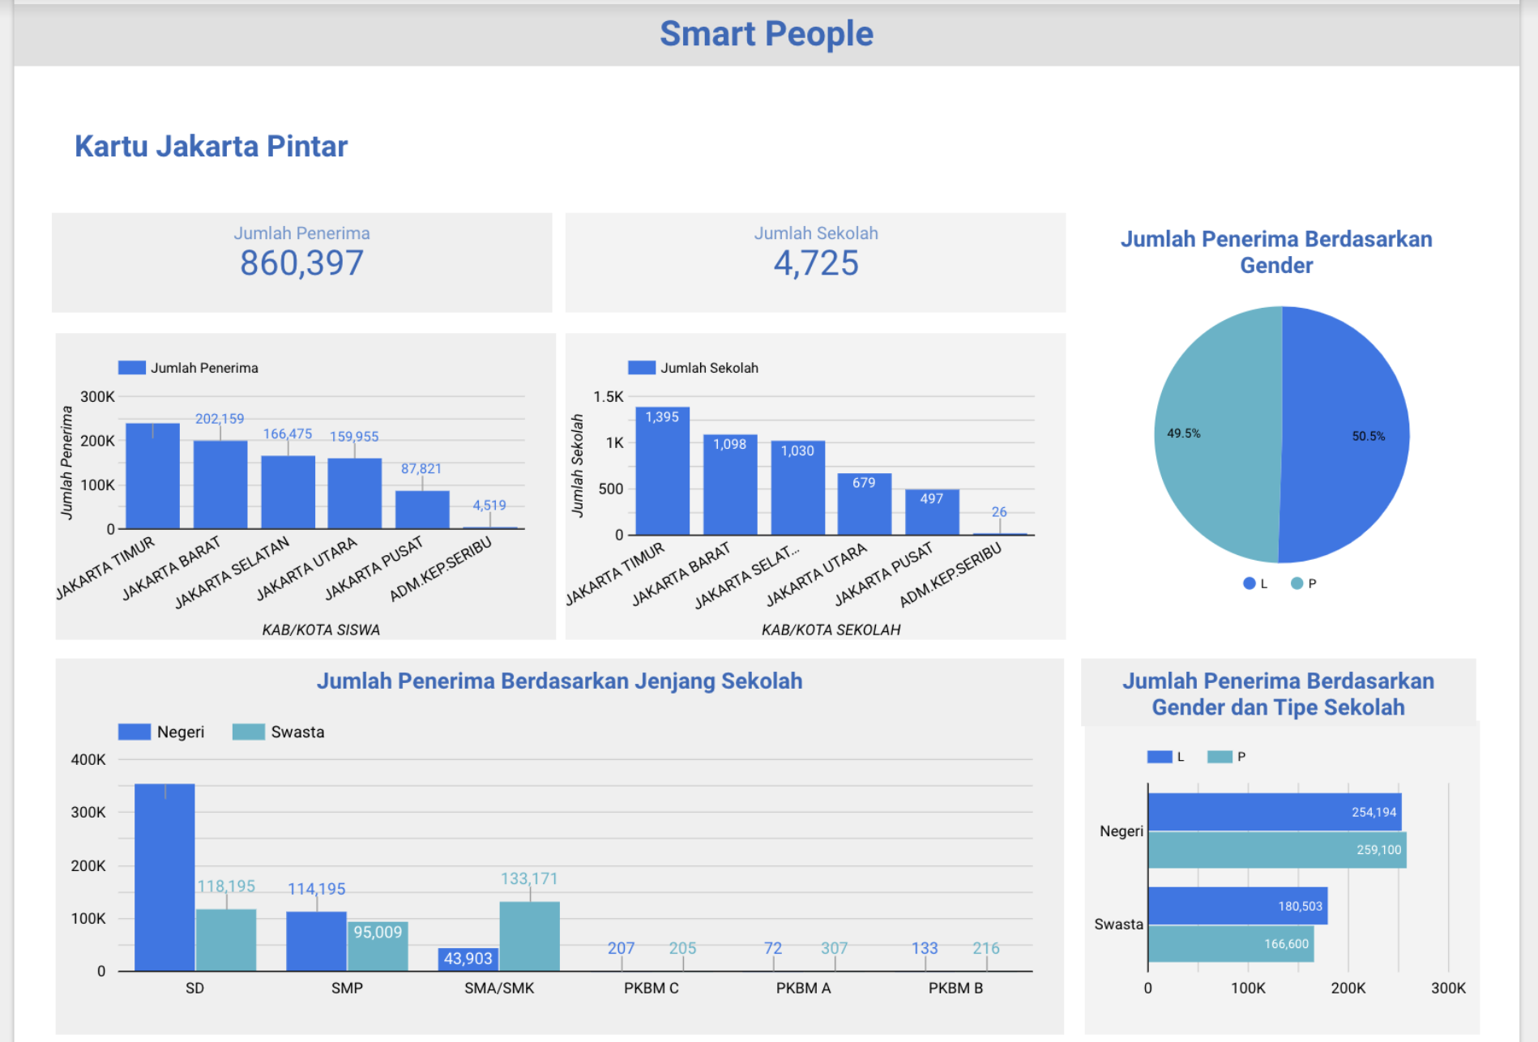
SUCCESS STORIES

Slide 12
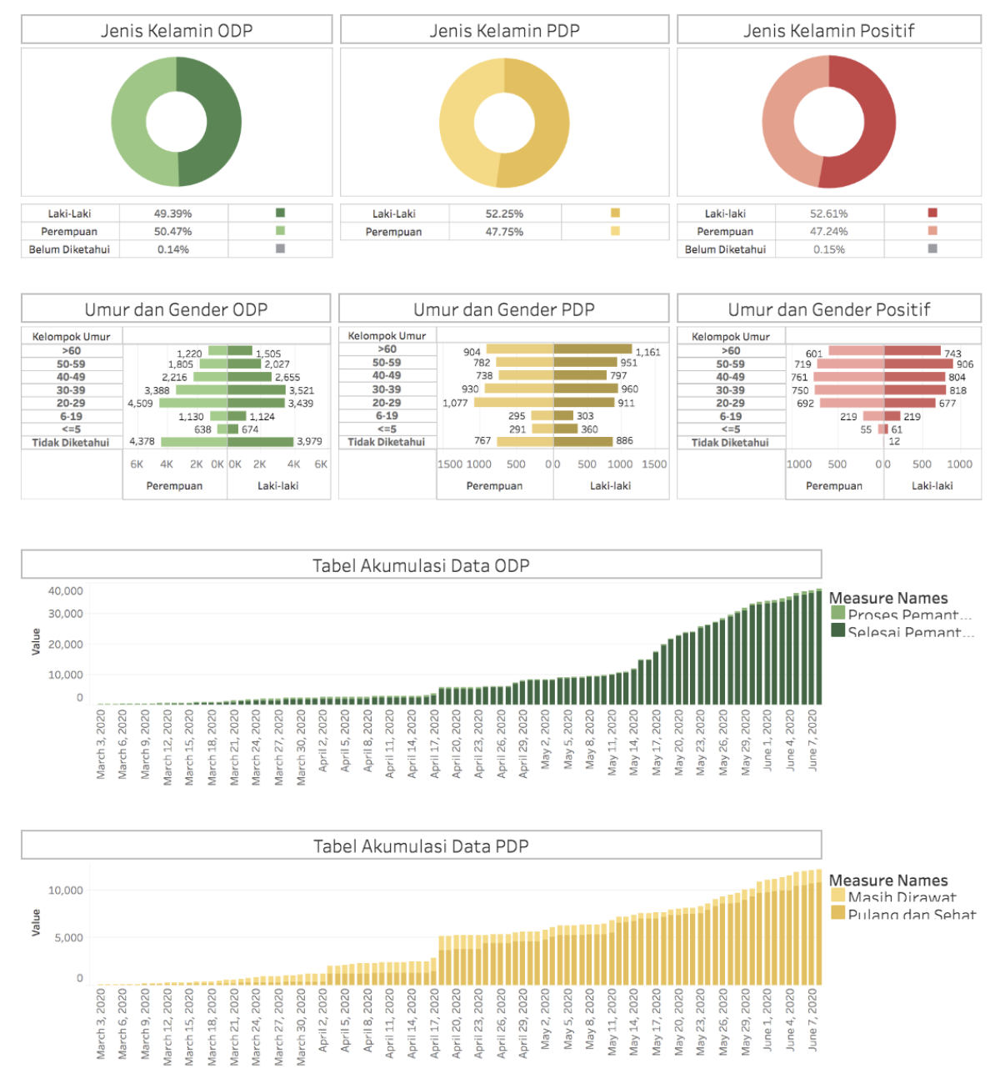
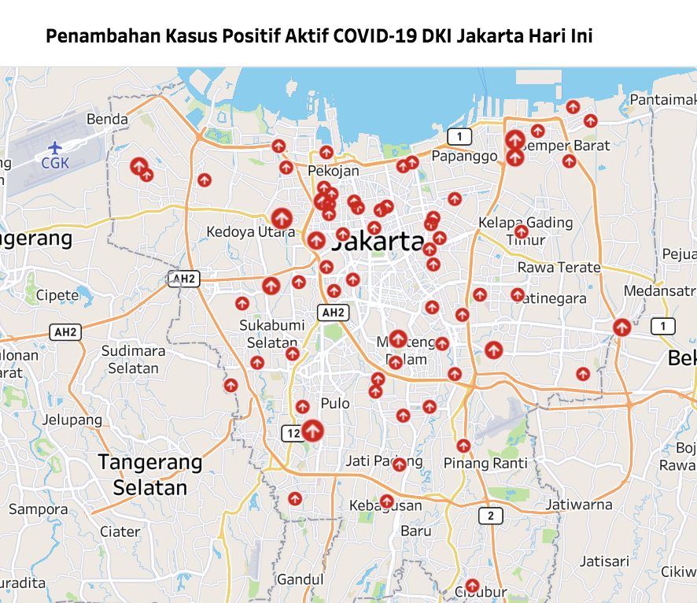
COVID-19 ANALYSIS

Slide 13
3
DATA VISUALIZATION PRINCIPLES

Slide 14
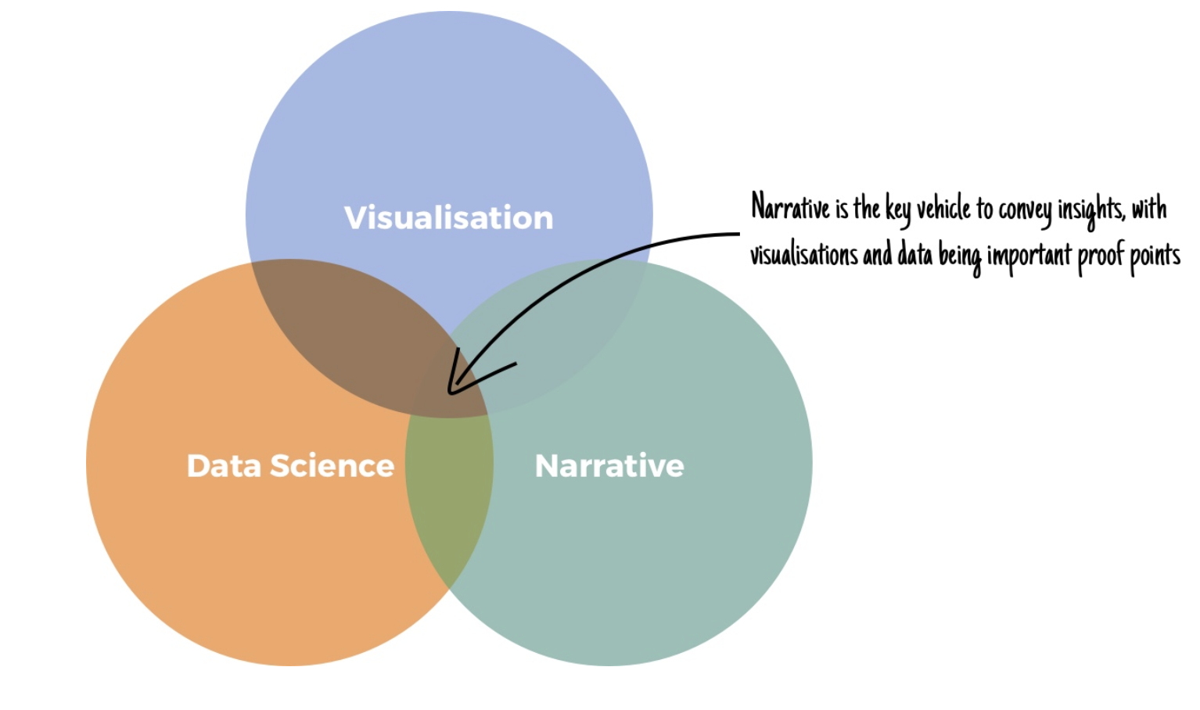
WHAT & WHY

Slide 15
WHAT & WHY

Slide 16
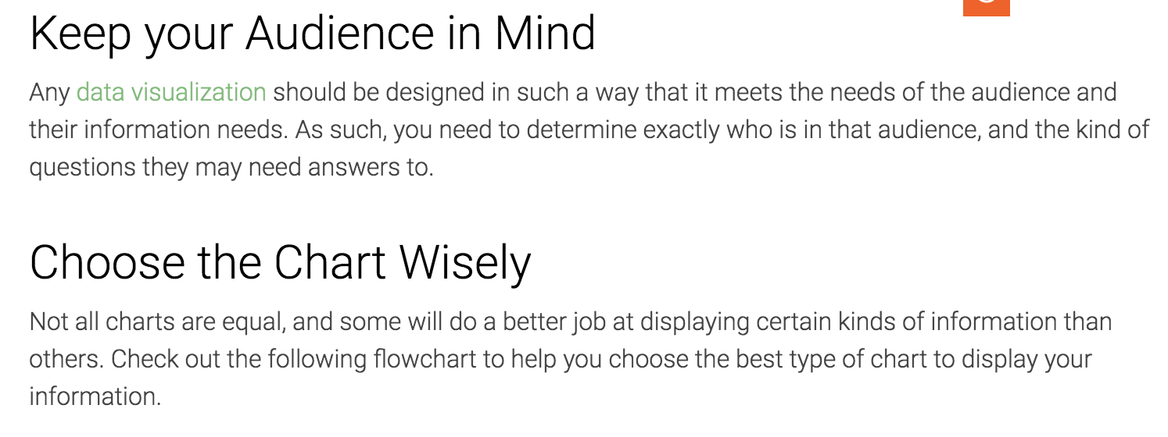
PRINCIPLES

Slide 17
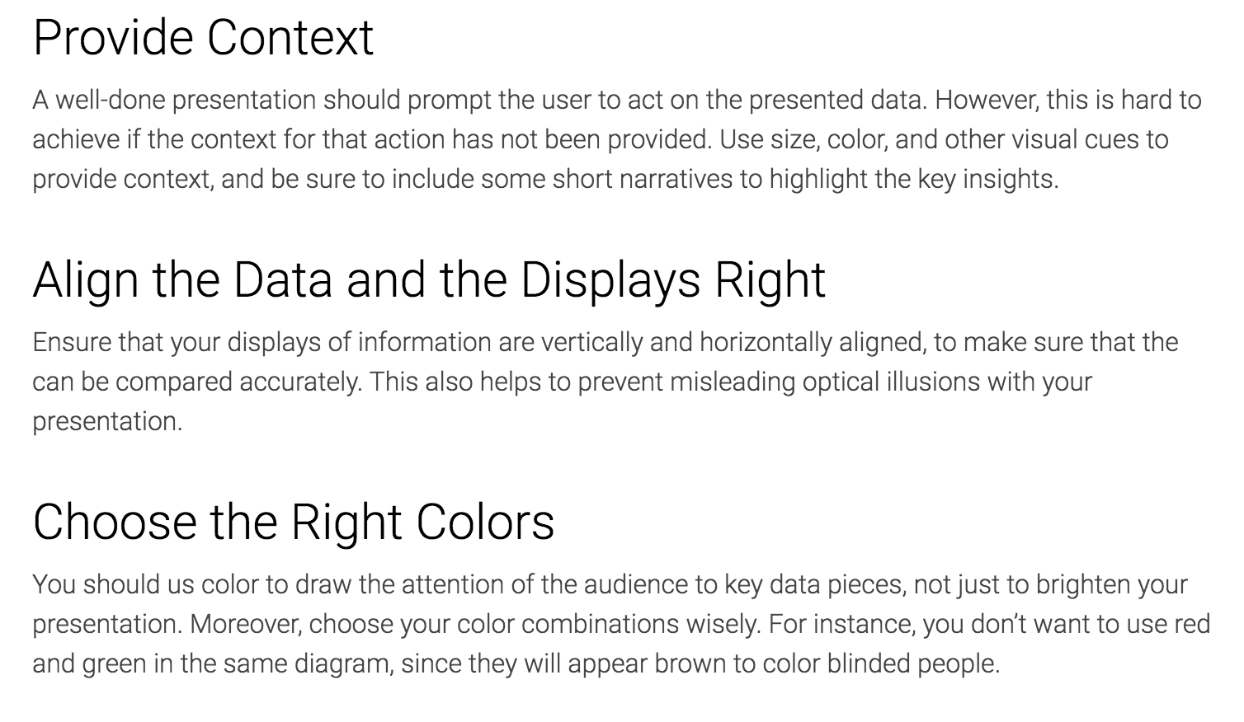
PRINCIPLES

Slide 18
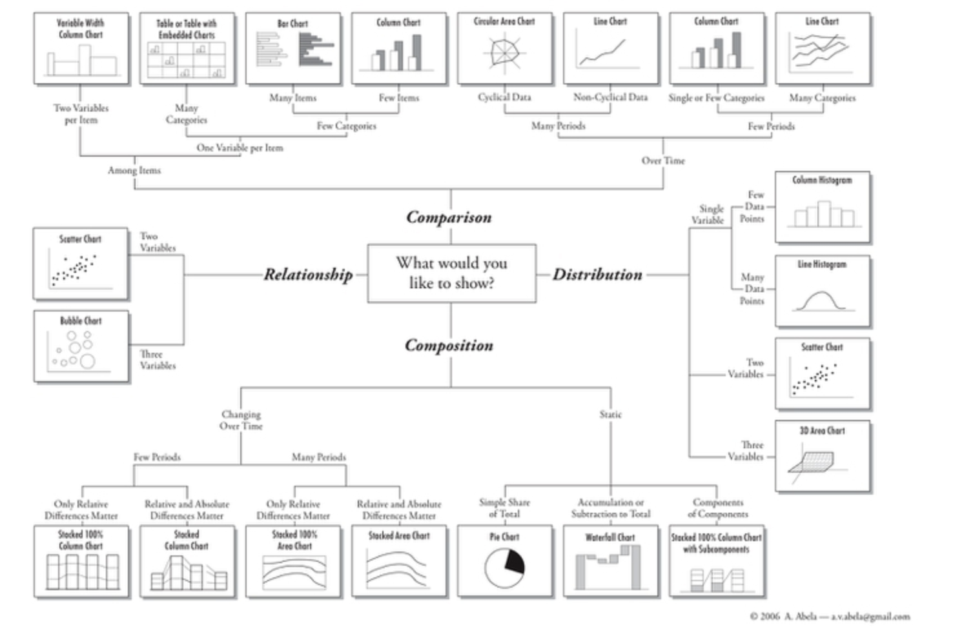
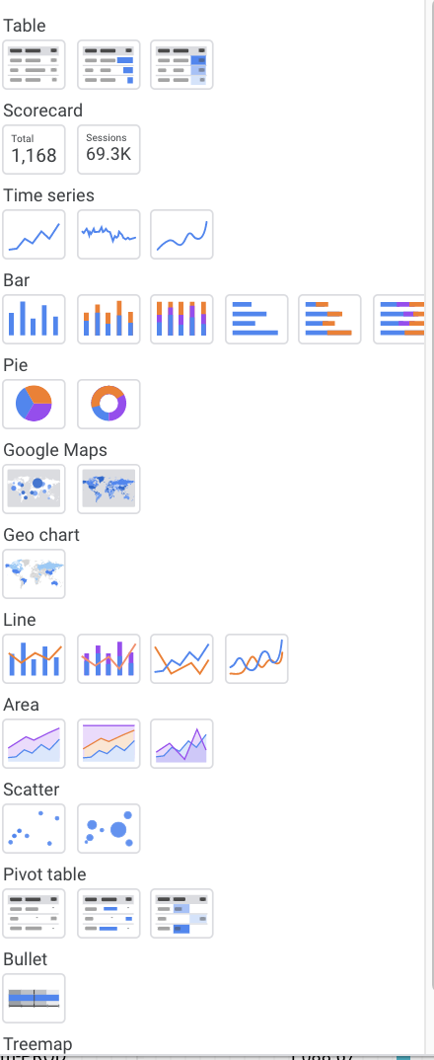
CHART VARIETIES

Slide 19
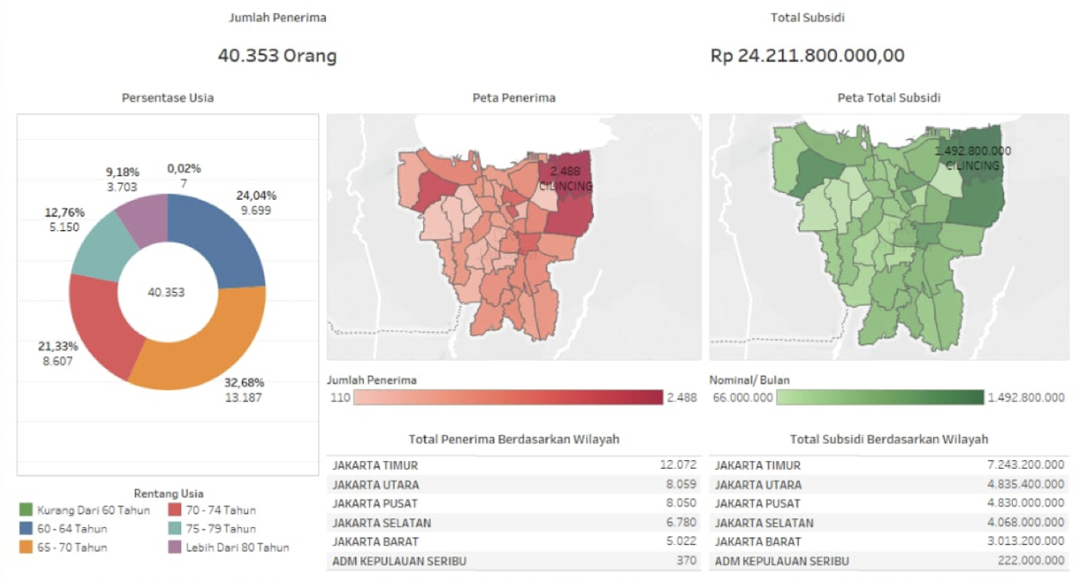
EXAMPLE

Slide 20
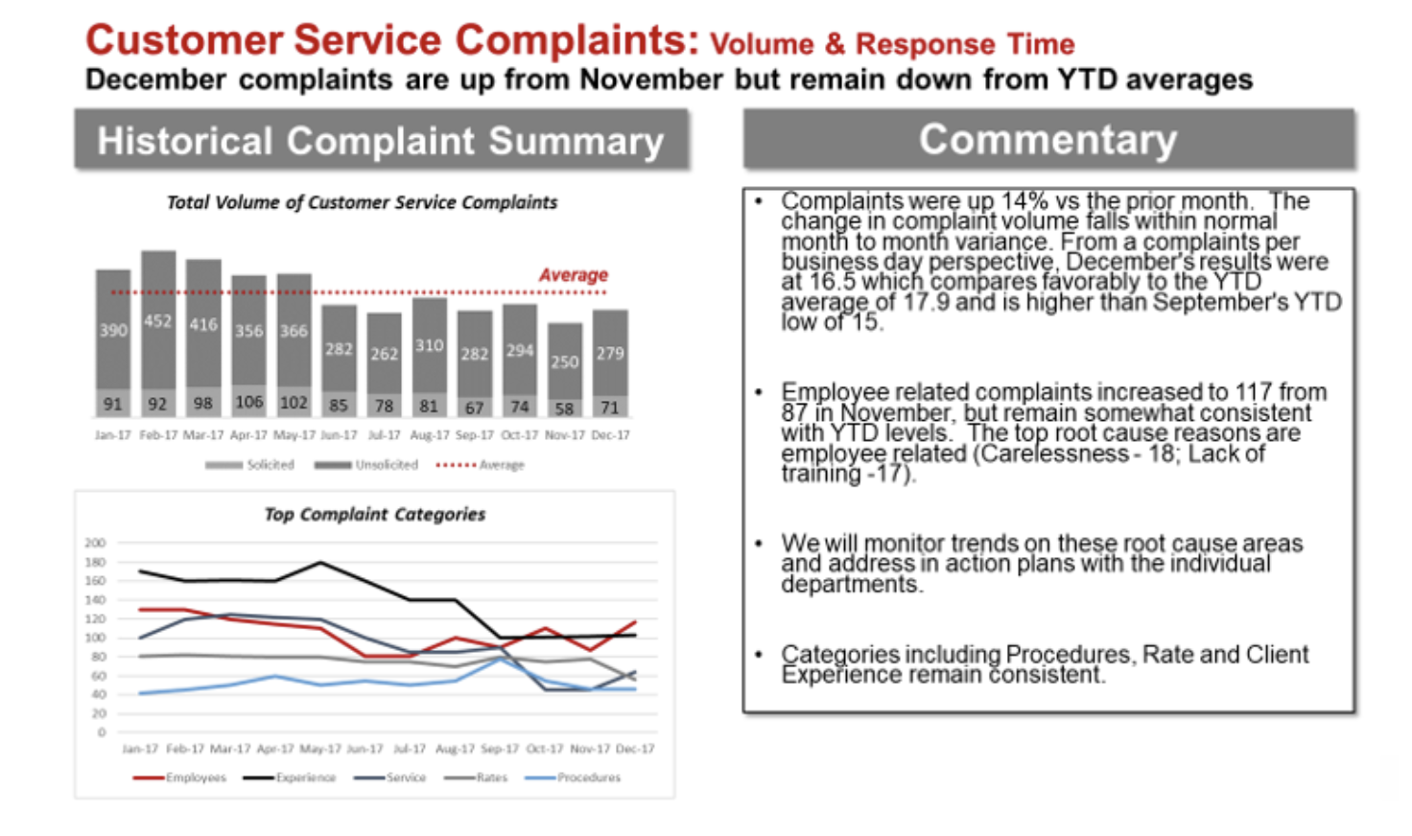
EXAMPLE (BAD)

Slide 21
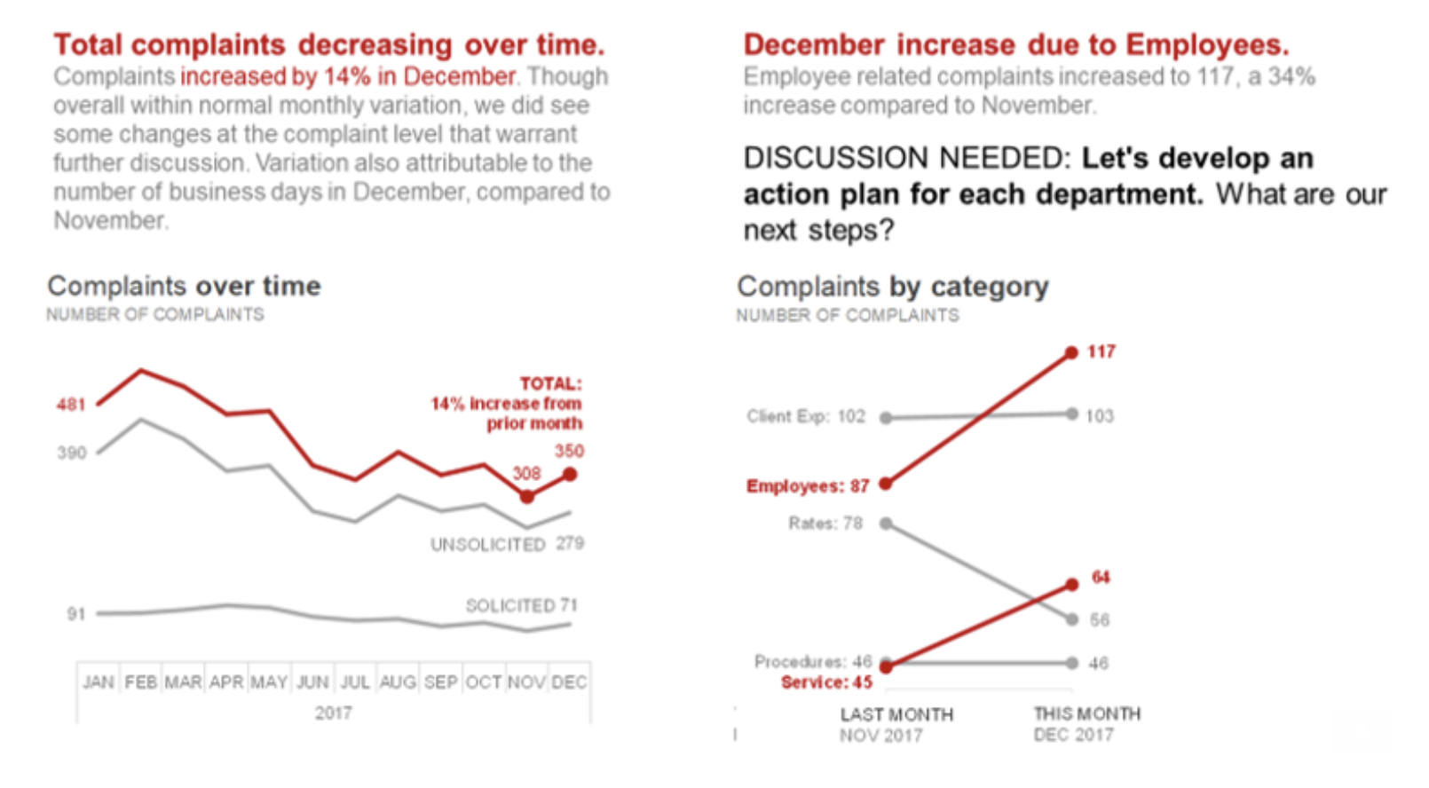
EXAMPLE (GOOD)

Slide 22
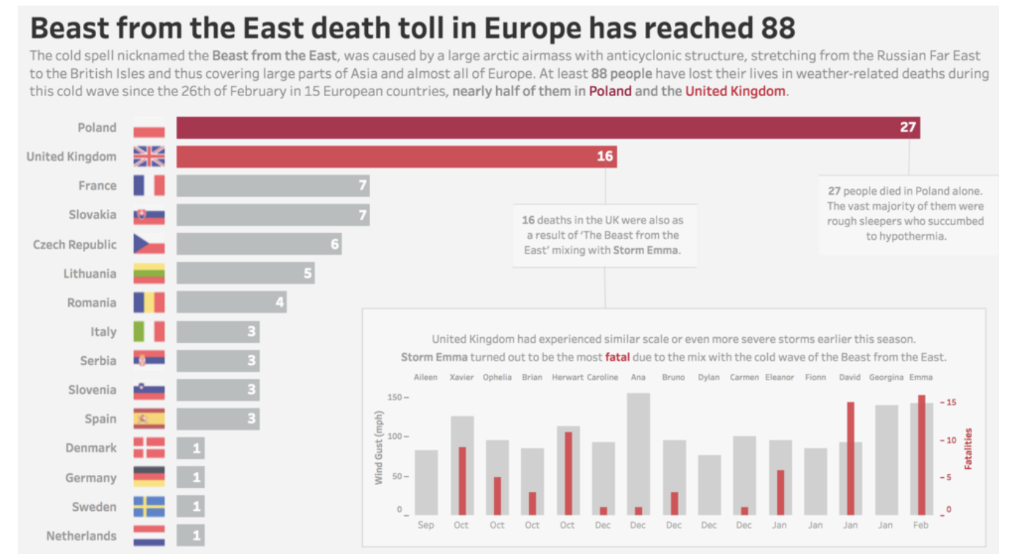
EXAMPLE (GOOD)

Slide 23
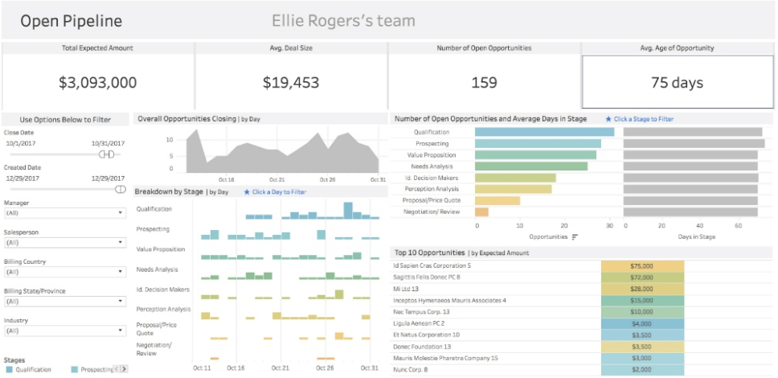
INDUSTRY EXAMPLE

Slide 24
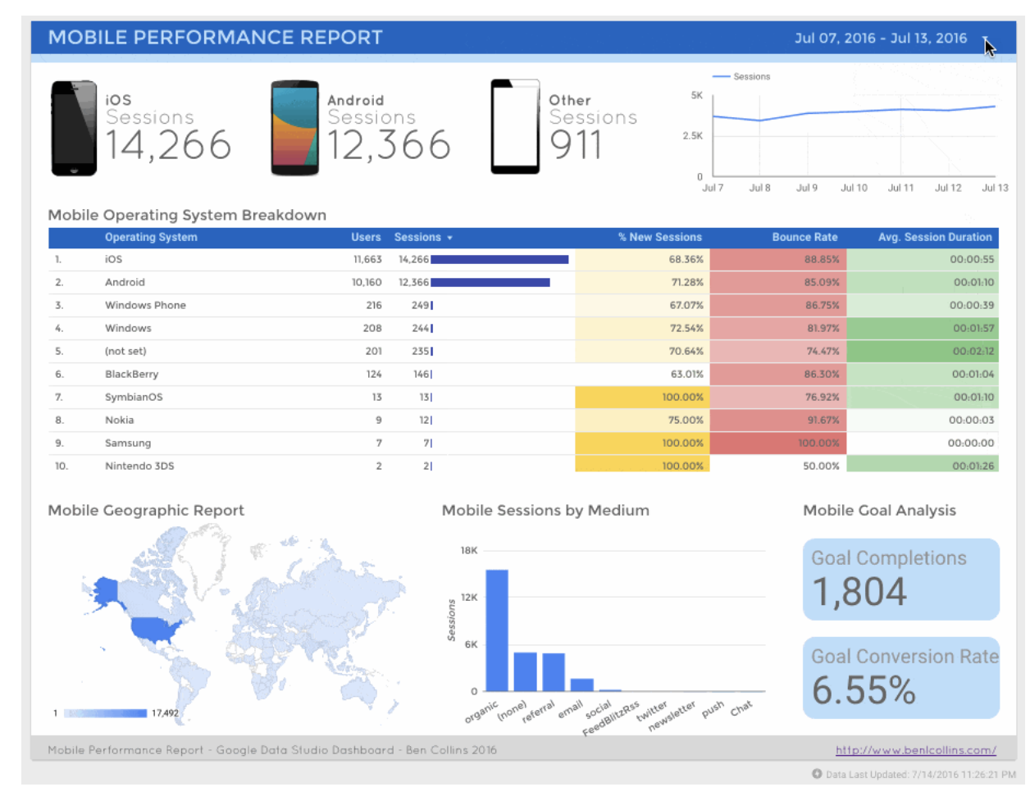
INDUSTRY EXAMPLE

Slide 25
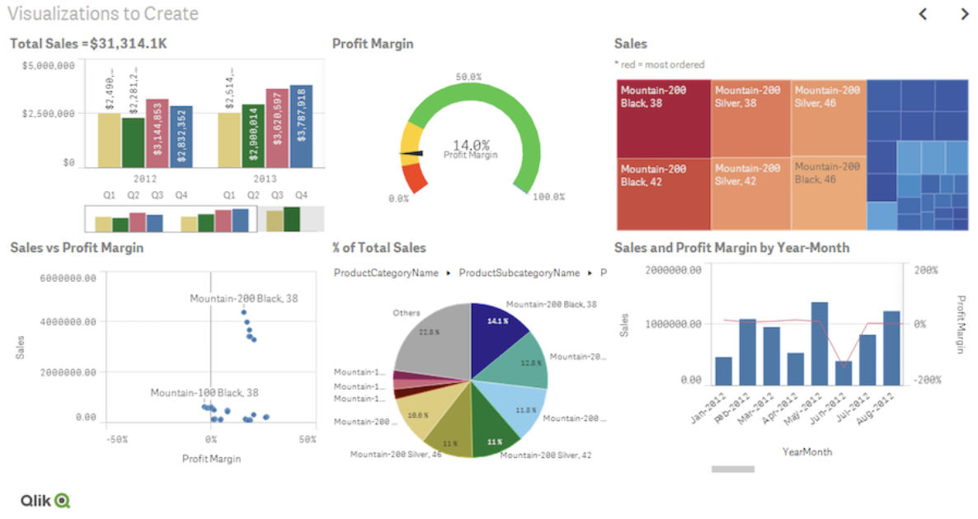
INDUSTRY EXAMPLE

Slide 26







TOOLS (NOT EXHAUSTIVE)

Slide 27

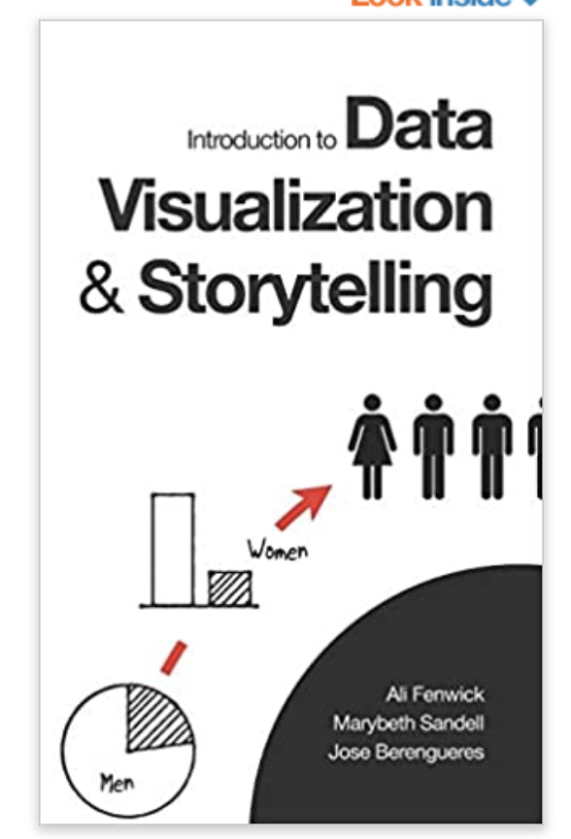

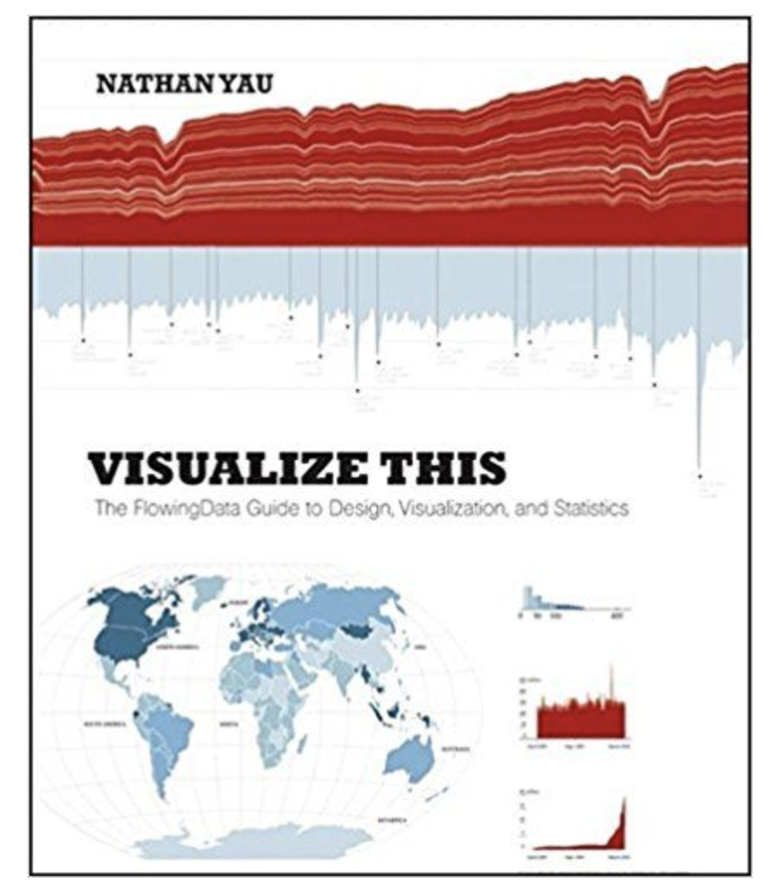
REFERENCES (NOT EXHAUSTIVE)

Slide 28
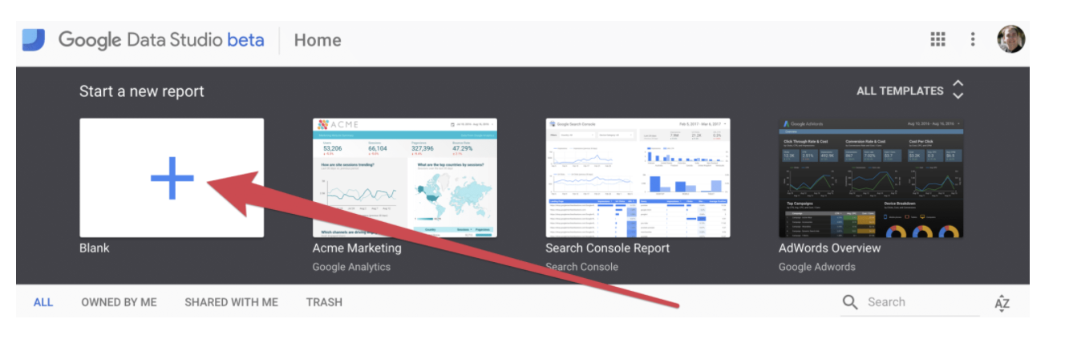
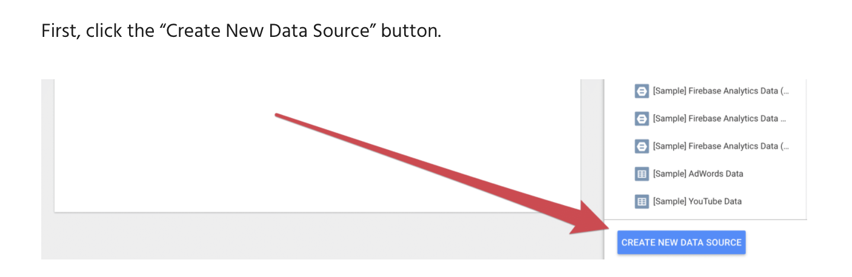
HANDS-ON

Slide 29
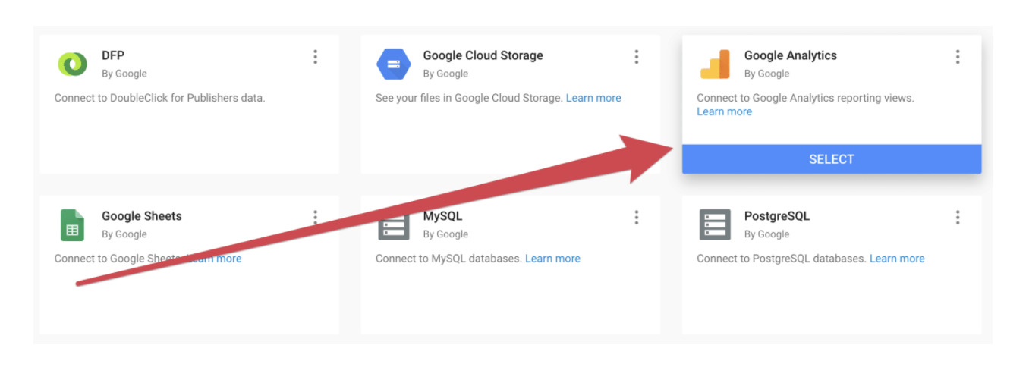
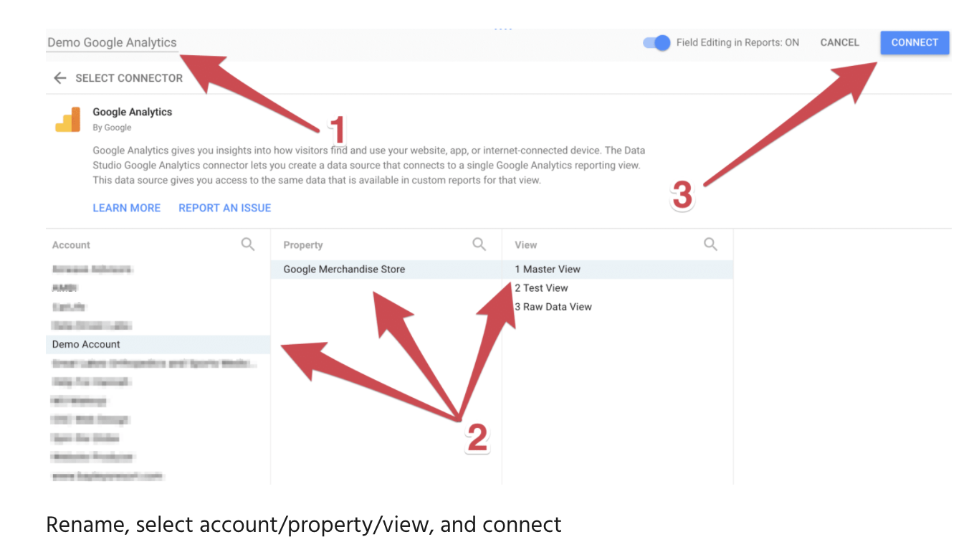
HANDS-ON

Slide 30
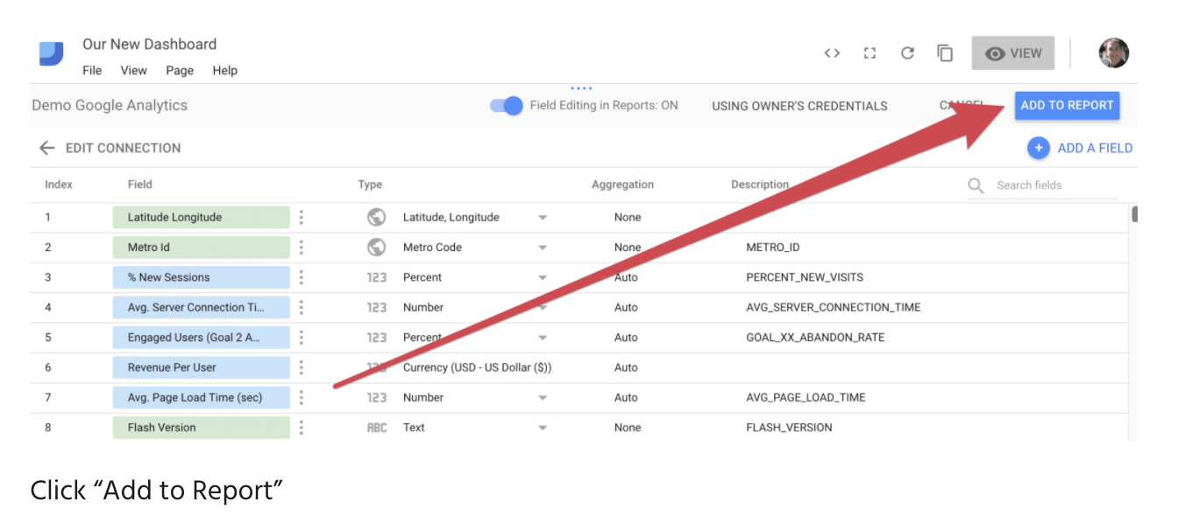
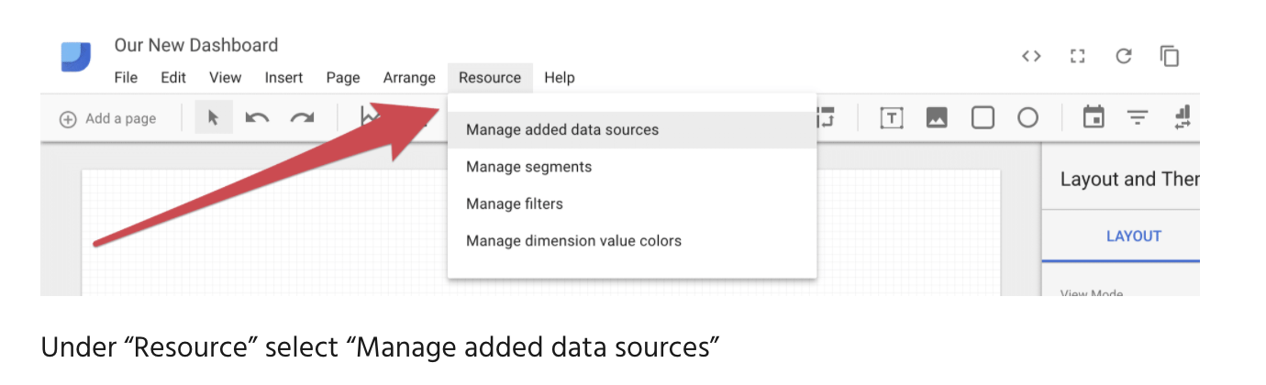
HANDS-ON

Slide 31
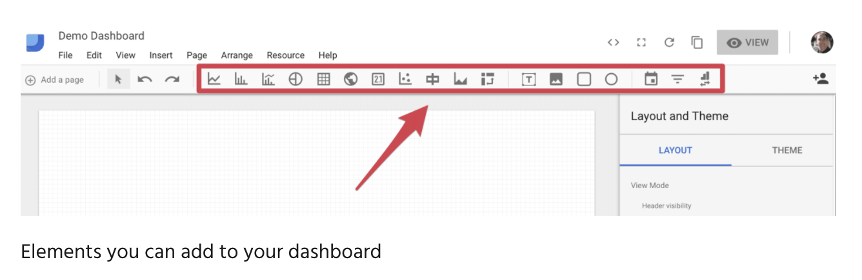
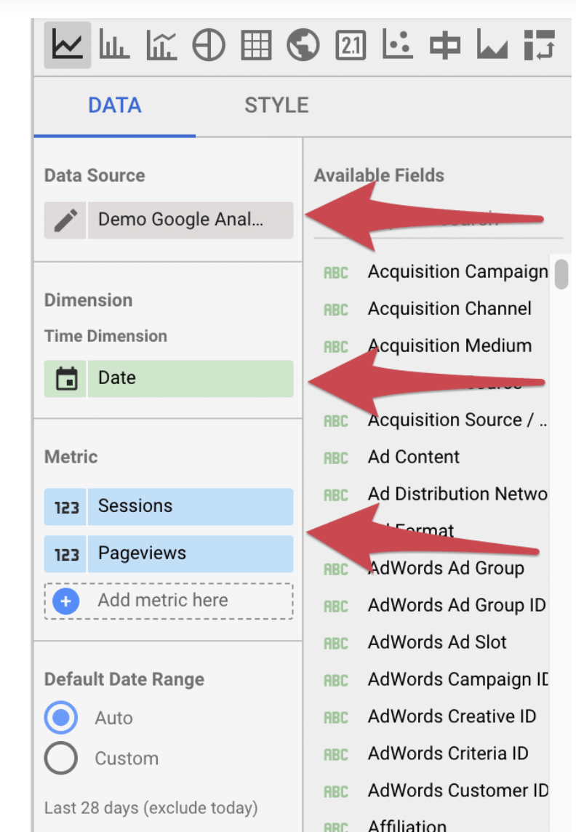
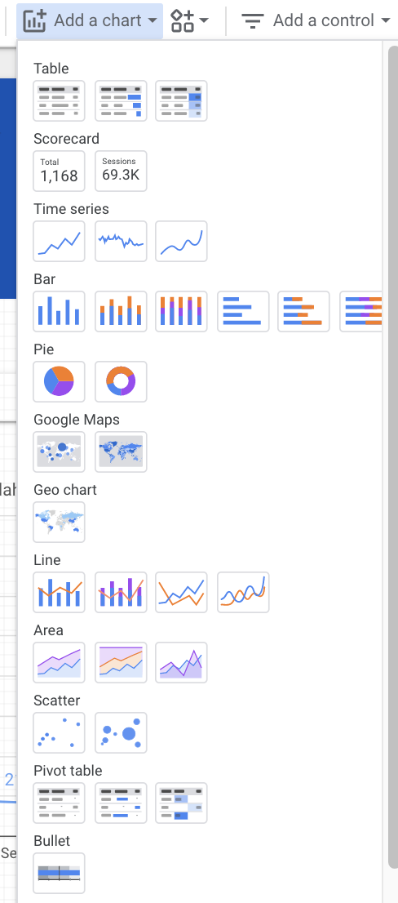
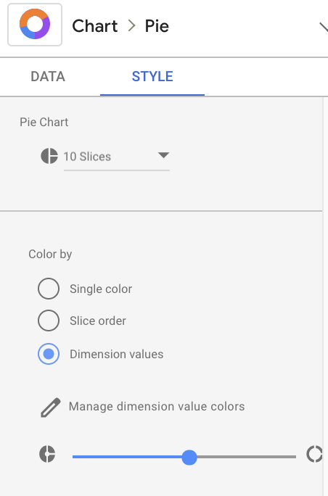
HANDS-ON

Slide 32


Thank You!

